Slide 1

POWERDESK
Submitted in partial fulfillment of the
Requirements for the award of the degree
of
Bachelor of Technology
in
Information Technology
By:
Gaganpreet Kaur (01276803109/IT/2009-2013)
Jasleen Kaur (00876803109/IT/2009-2013)
Nikhil Garg (04176803109/IT/2009-2013)
Samneet Singh (01176803109/IT/2009-2013)
Under the Guidance of:
Mr. Nikhil Gupta
Department of Information Technology
Guru Tegh Bahadur Institute of Technology
Guru Gobind Singh Indraprastha University
Dwarka,New Delhi
Year 2012-2013

Slide 2
CONTENTS
Introduction
Technical Requirements
Compression & Decompression Module
Split/Merge file module
Split text file module
Split pdf module
Advantages
Conclusion

Slide 3
POWERDESK
POWERDESK is a completely utility based project that throws light on basic problems faced by user while handling large files by providing lucrative solutions that can be classified according to the following modules:
COMPRESSION /DECOMPRESSION
SPLIT /MERGE FILES
TEXT FILES SPLITTING
PDF FILES SPLITTING

Slide 4
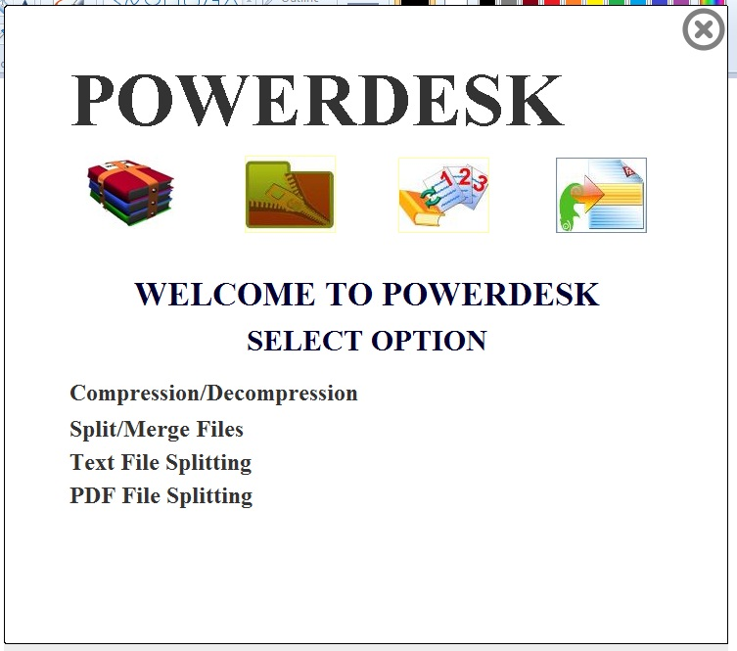
POWERDESK-USER INTERFACE

Slide 5
TECHNICAL REQUIREMENTS
HARDWARE REQUIREMENTS
SOFTWARE REQUIREMENTS
Operating System: Windows XP
Professional/ Windows VISTA
Java development kit (JDK)
NetBeans IDE 7.1.1
RAM: 1 GB
Hard-disk space: 250 MB

Slide 6
COMPRESSION MODULE
User can easily browse the file to be compressed.
User can select the destination folder according to his own choice.
The compressed file has .gz extension.
The compression details i.e. the original size, compressed size and compression ratio are also displayed while compressing the file.
The main algorithm that we use here is GZIP algorithm .

Slide 7
GZIP ALGORITHM
Huffman’s algorithm + LZ77 compression.
LZ77 compression keeps track of the last n bytes of data seen, and when a phrase is encountered that has already been seen, it outputs a pair of values corresponding to the position of the phrase in the previously-seen buffer of data, and the length of the phrase
HUFFMAN ALGORITHM is a prefix coding . It consists of replacing commonly used symbols with shorter representations and less commonly used symbols with longer representations

Slide 8
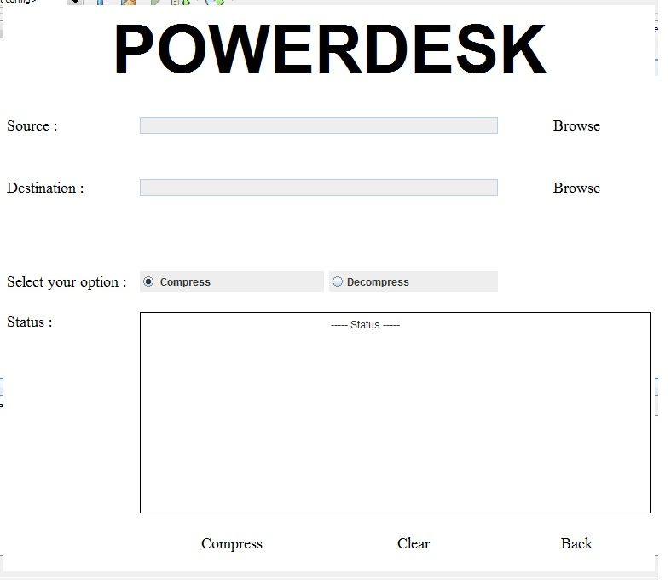
COMPRESSION – USER INTERFACE

Slide 9
DECOMPRESSION MODULE
The decompressing of .gz file is done which is created at the time of compression.
User can select the destination folder according to his own choice.
The decompression details i.e. size of compressed file, original size and decompression ratio are also displayed while compressing the file.

Slide 10
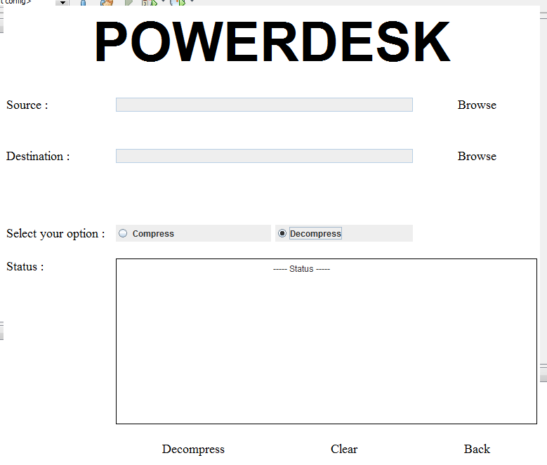
DECOMPRESSION – USER INTERFACE

Slide 11
SPLIT MODULE
Done on the basis of file size.
User can select the size of the segment according to his own choice.
The user can select the destination folder also according to his choice.
Simple user interface.

Slide 12
MERGE MODULE
Merging is done by selecting the .meta file created at the time of splitting.
The .meta file contains the sequence and the size of each segment files.
The user can select the destination folder also according to his choice.
The user has an option of deleting the segment files after merging.
Simple user interface.

Slide 13
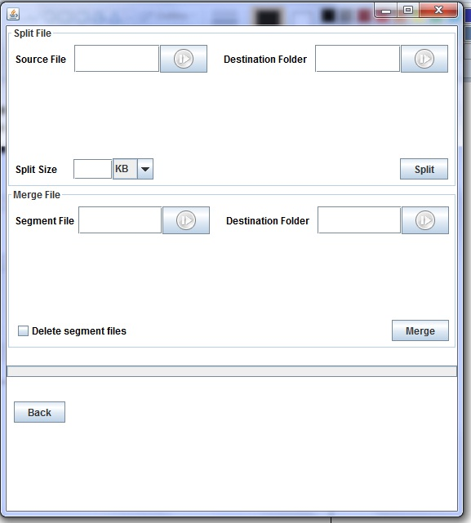
SPLIT MERGE USER INTERFACE

Slide 14
TEXT FILE SPLIT
It is used to split the text file.
The user specifies the number of lines by which the text file must be split.
Information of the splitting is also displayed while splitting a text file with Powerdesk.

Slide 15
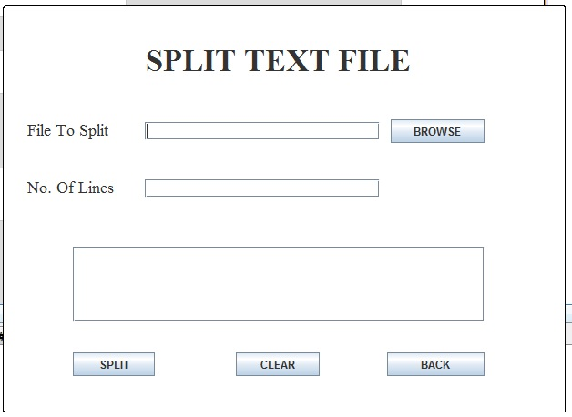
SPLIT TEXT FILE – USER INTERFACE

Slide 16
PDF FILE SPLITTING
It is used to split the pdf files.
The user specifies the number of pages by which the pdf file must be split.
It is useful when you need to send a specific page from the pdf file instead of creating a new file from scratch.
Information regarding splitting is also shown.

Slide 17
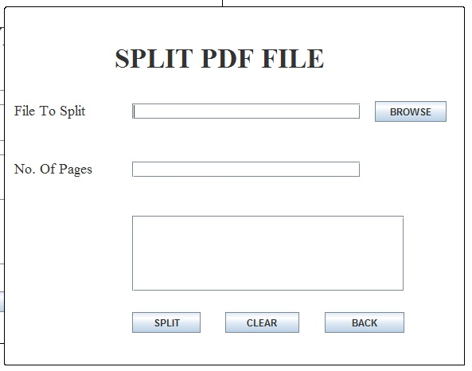
SPLIT PDF FILES - USER INTERFACE

Slide 18
ADVANTAGES OF POWERDESK
The complete solution of compressing, decompressing, splitting and merging a file.
Any of the operations can be made on any type of file.
Two special types of splitting for text and pdf files.
Simple user interface.
It is build in java so only JRE is required to run this application, independent of any operating system.
The compression ratio achieved is equal to WinRar in many file types.

Slide 19
CONCLUSION
The system provides a user friendly approach.
It is developed with modular approach.
The software doesn’t need a third party software like winrar, winzip etc.
It compresses files and can be used to decompress them when need arises.

Slide 20
THANK YOU

